Slide 1


Big Mountain Resort

Slide 2
Problem Statement Worksheet (Hypothesis Formation)
By implementing a dynamic pricing strategy based on real-time data analysis of visitor patterns and facility usage, Big Mountain Resort will increase its average ticket price by 10% and overall revenue by 15% within the next ski season, while maintaining or improving customer satisfaction levels.
H
1
Context
4
Constraints within solution space
Big Mountain Resort, a premium ski resort, has recently installed an additional chair lift to help increase the distribution of visitors across the mountains. This additional chair increases their operational costs by $1,540,000 for this season. Despite charging more than average price, the resort suspects that its current pricing strategy is not maximising the revenue potential.
Potential constraints would be: - Limited access to data
Resistance from stakeholders to change the pricing
Optimising the ticketing(changing ticket price) while maintaining the visitor’s satisfaction
2
5
Stakeholders to provide key insight
Criteria for success
The resort needs to optimise the ticketing policy without compromising on visitor’s satisfaction.
Director of Operations, Jimmy BlackBurn
- Database Manager, Alesha Eisen
3
Scope of solution space
6
Key data sources
The solution will involve analyzing data from 330 similar resorts and Big Mountain Resort to develop a data-driven pricing strategy and identify potential cost-saving measures. This includes evaluating the importance of various facilities and services.
CSV file containing record of 330 resorts in US and data for Big Mountain Resort
Data snippets
H
D
E
I
P
Notes:
Hypothesis: Create a Hypothesis with an emphasis on SMART principles. (S – Specific, M – Measurable, A – Achievable, R – Realistic, T – Timebound). If you cannot do this, you do not have a good grasp on the business problem.
Context: With context, we have clearly identified the problem at hand and have elucidated on how our initiative may solve this problem, alongside the commercial implications this will have on the business.
Criteria for Success: Clearly defining the criteria for success ensures that the scope of your work is clearly defined and understood. Otherwise, if this isn’t defined – your work will never end which will result in mismatched expectations.
Scope of Solution Space: Scoping out the solution space ensures that the business initiative is SPECIFIC for a certain segment or area. This prevents solutions that have been developed being scaled and applied for all other business units that the solution may not be responsible or scalable for.
Constraints within Solution Space: Looking forward, what are the foreseeable problems we are likely to encounter? Could this be stakeholder resistance? Could this be we don’t have access to the right data?
Stakeholders to provide key insight: Who are the people I need to speak to, to get the answers I need for my data analysis?
What key data sources are required?
Based off my discussions with the key stakeholders – can we clearly list out all the data sources we need so we can make a highly targeted request as opposed to a scatter-gun approach where we ask for a bit of everything?

Slide 3
Recommendations
Our model suggests that Mountain Resort Ticket price is lower than the predicted model price by $16.96, and the resort have many potential scenarios for either cutting costs by closing runs or increasing ticket price by increasing vertical drop, adding acres snow making or increasing the longest run.
Increasing the vertical drop by 150 ft would increase the ticket price by $7.00, resulting in revenue increase by $12,250,324
Adding 2 acres of snow making would increase ticket price by $8.26 resulting in increased revenue of $14,454,028

Slide 4
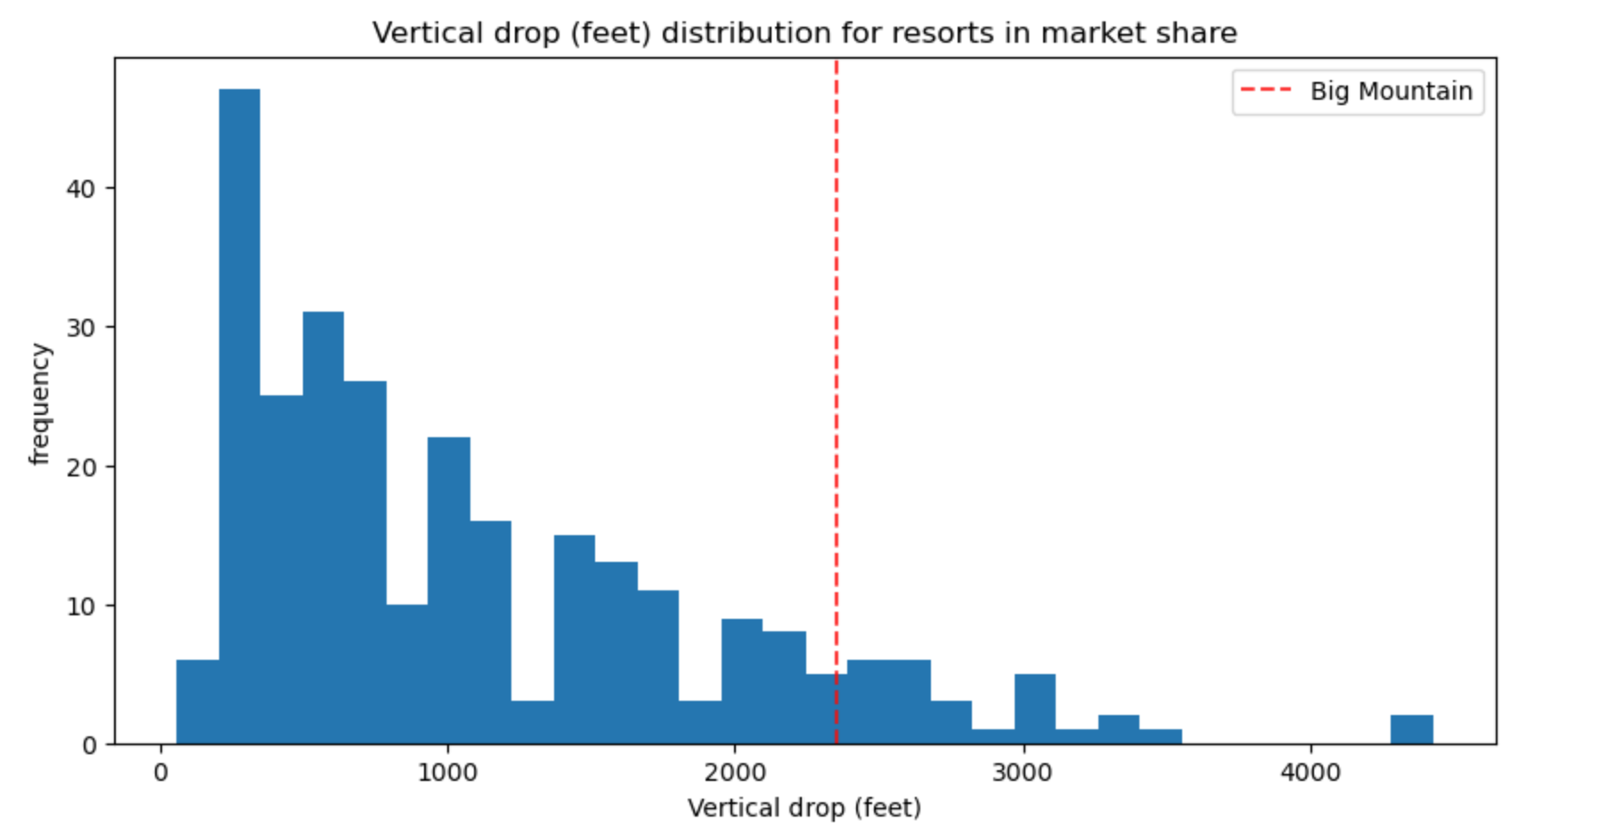
Modelling Results and Analysis
Big Mountain is doing well for vertical drop, but there are still quite a few resorts with a greater drop.

Slide 5
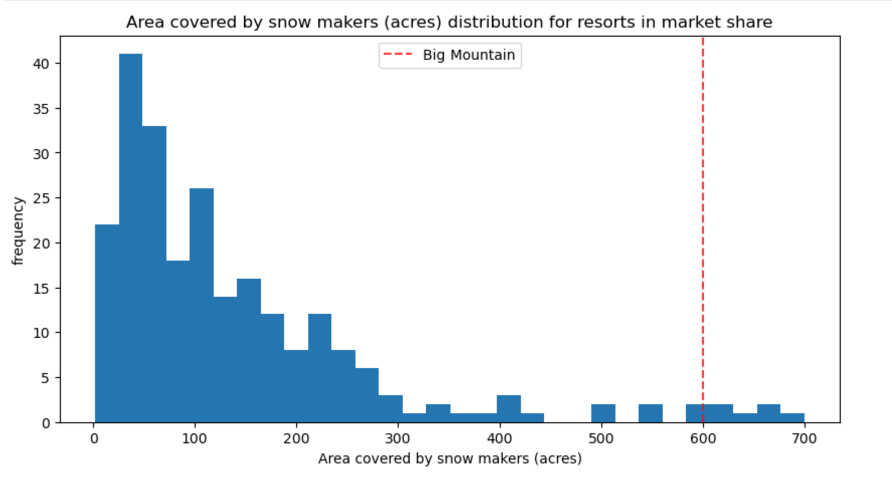
Modelling Results and Analysis
Big Mountain is very high up the league table of snow making area.

Slide 6
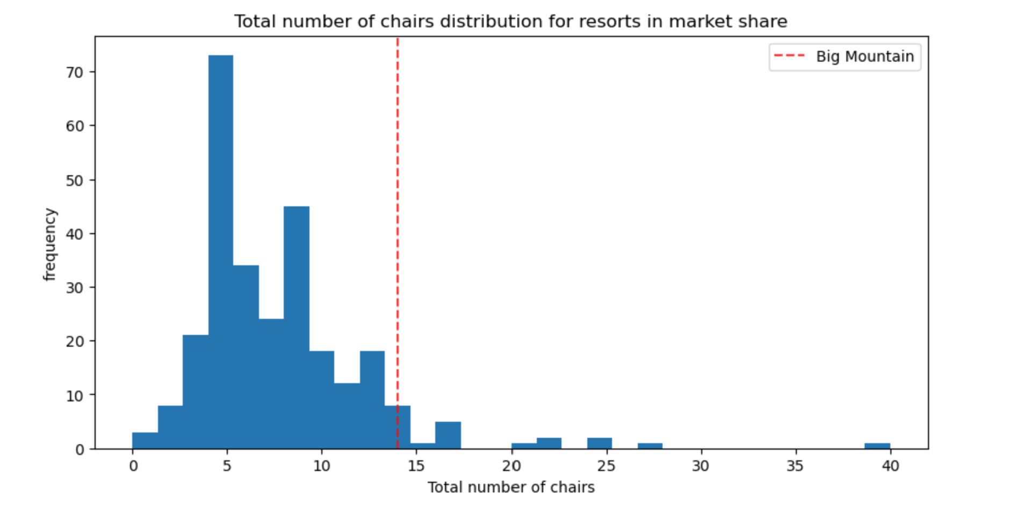
Modelling Results and Analysis
Big Mountain has amongst the highest number of total chairs, resorts with more appear to be outliers.

Slide 7
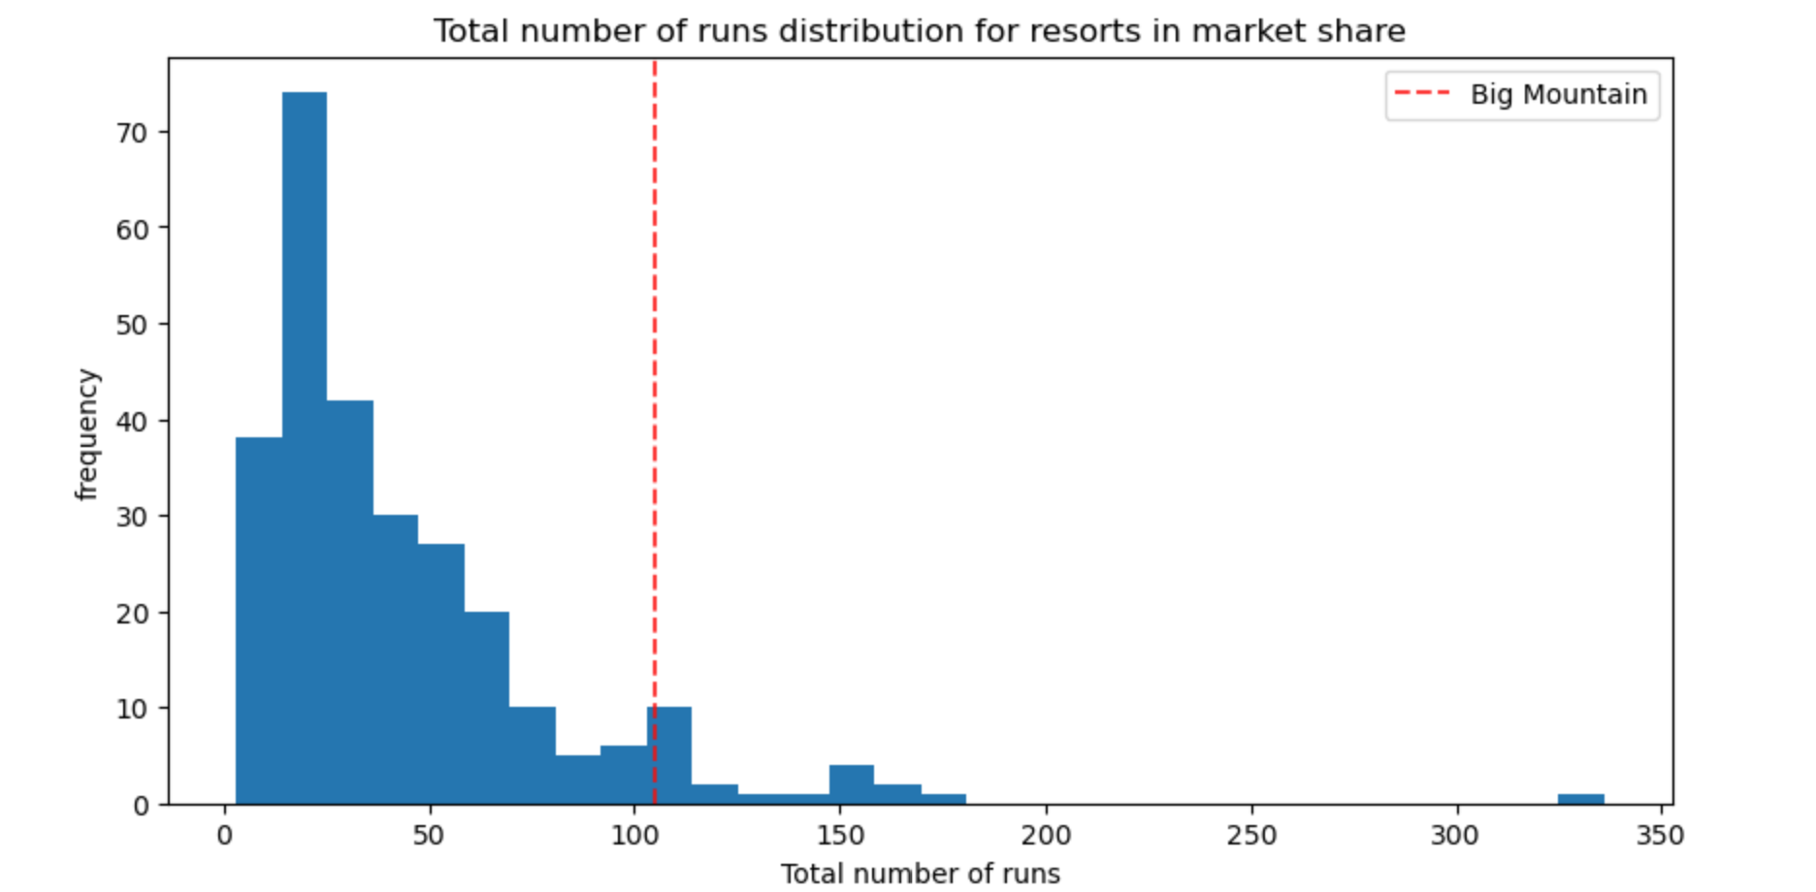
Modelling Results and Analysis
Big Mountain compares well for the number of runs. There are some resorts with more, but not many.

Slide 8
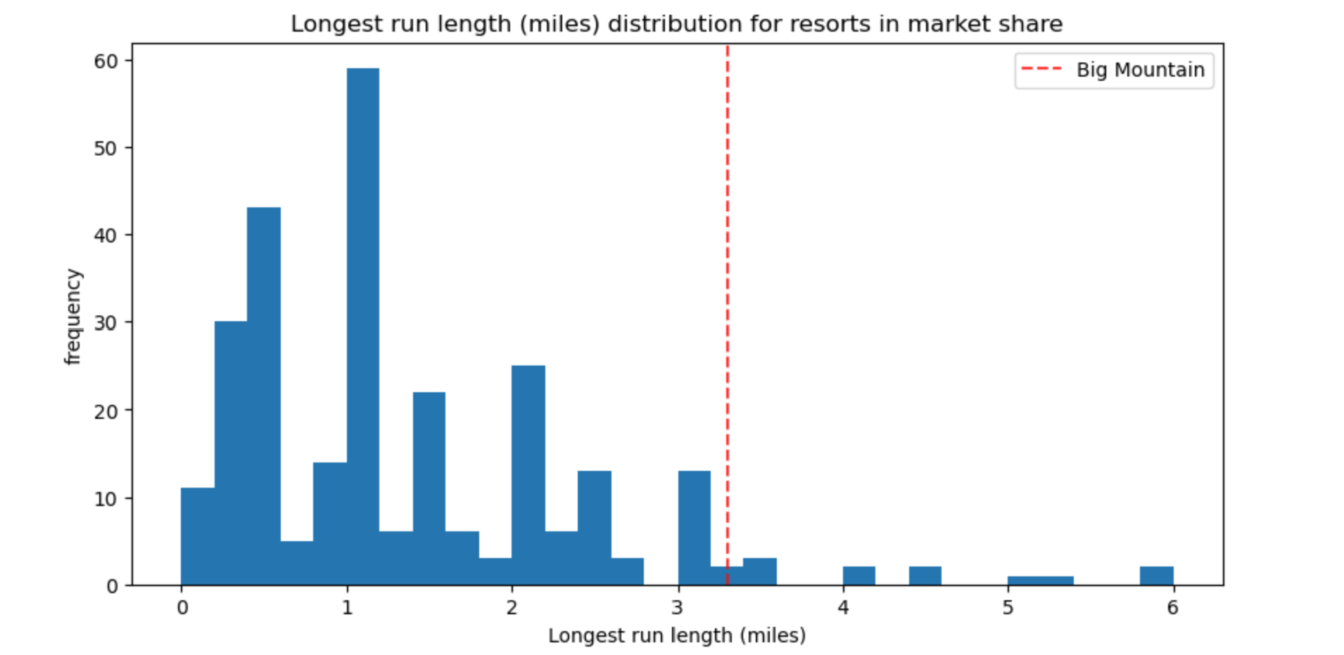
Modelling Results and Analysis
Big Mountain has one of the longest runs. Although it is just over half the length of the longest, the longer ones are rare.

Slide 9
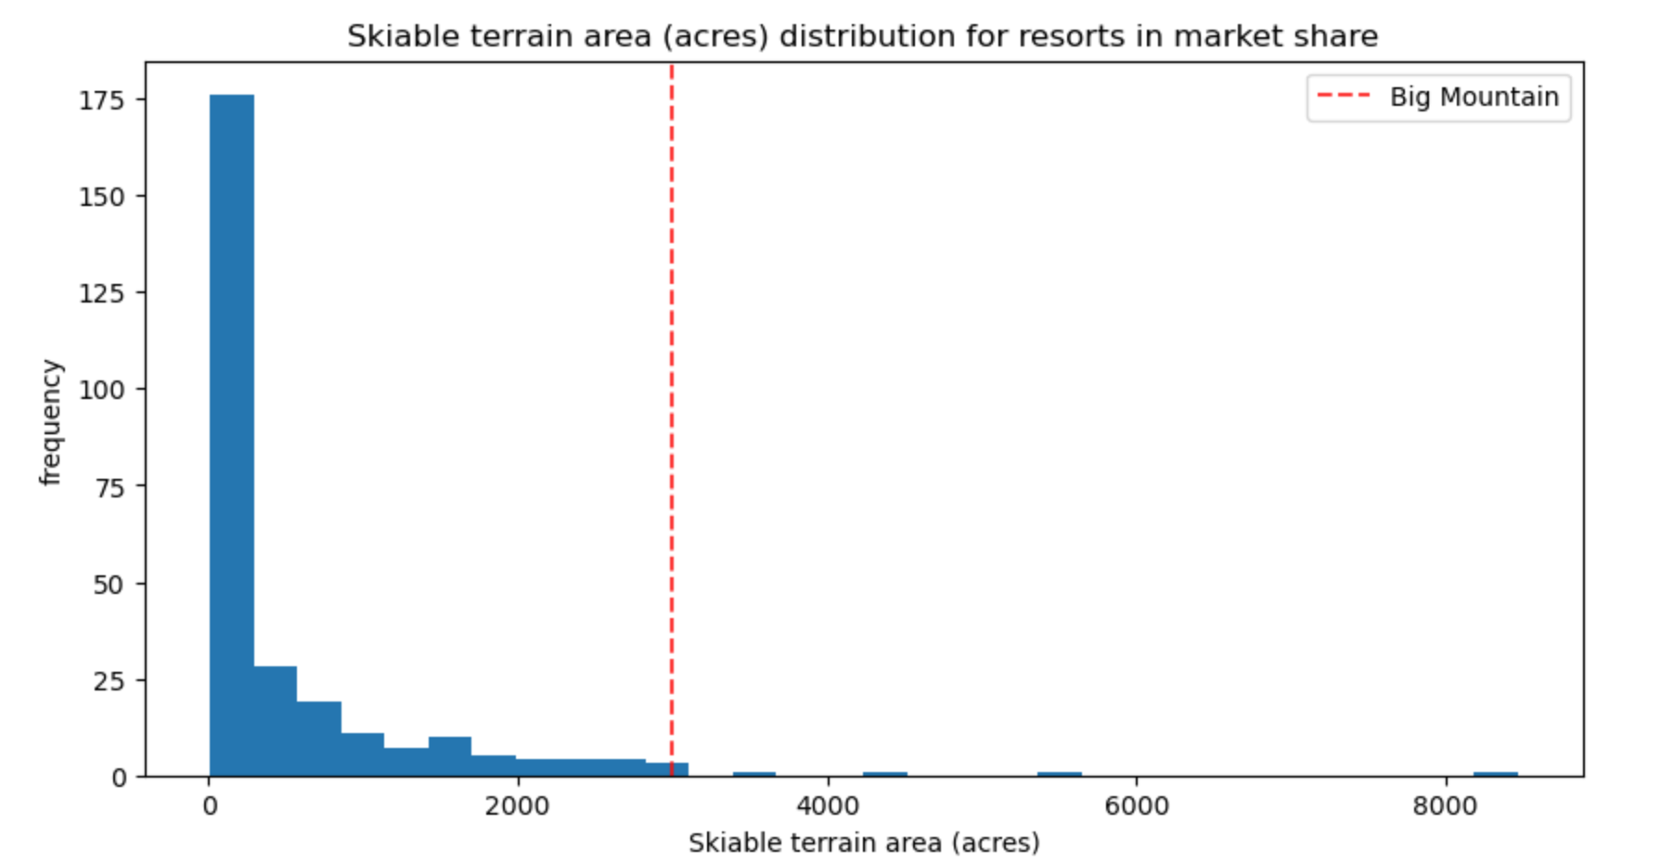
Modelling Results and Analysis
Big Mountain is amongst the resorts with the largest amount of skiable terrain.

Slide 10
SUMMARY
Current Pricing: The modeled ticket price for Big Mountain Resort is $97.96, while the actual price is $81.00. This suggests that the resort might be undercharging compared to other resorts.
Feature Analysis: Big Mountain is on the higher end for features like ‘vertical drop, snow making, total number of chairs, runs, longest run, and skiable terrain’. It has no tram but one fast quad.
Modeling Scenarios:
Closing Runs: Closing up to 5 least used runs shows no significant impact on ticket prices or revenue. Closing more than 5 leads to a sharp drop.
- Increasing Vertical Drop: Adding a run with an additional chair lift justifies a $7.00 increase in ticket price, equating to $12,250,324 in revenue.
- Adding Snow Making: Enhancing the above scenario with 2 acres of snow making increases the ticket price by $8.26, resulting in $14,454,028 in revenue.
- Longest Run: Increasing the longest run by 0.2 miles with additional snow making shows no difference in price.
Recommendation: Closing up to 5 least used runs is advisable as it avoids the costs of new lifts and snow making, maintaining revenue without additional operating costs. The business can test this by gradually eliminating runs based on usage and monitoring ticket sales.

